Slide 1
DOE Lecture 1
“What is An Experiment?”

Slide 2
Introduction
You are used to analyzing data and reporting a p-value; however, such analyses do not necessarily come from experiments. The data may be based upon:
Convenience Sample.
Observational Studies where the variable of interest may be “randomly dispersed in the population”
Probability Based Sampling methods.
Experimental designs. <- Causal Analysis

Slide 3
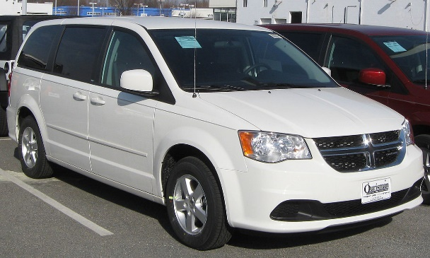
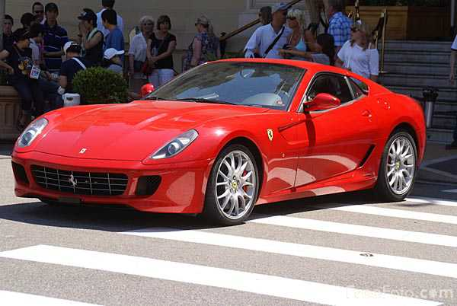
Why Experimental Design?
Average Speed:
64.2, 66.2, 67.0, 67.6,
67.8, 68.5, 68.8,
68.8, 68.9, 69.1
Average Speed:
69.2, 70.1, 70.2,70.7,
70.8, 71.0, 71.5
72.5, 73.5, 73.8
Mini-van Drivers
Sports Car Drivers
Question: Do people drive faster when they
drive a sports car?

Slide 4
To compare two groups:
We can use a T-Test procedure
This is one of the standard analysis techniques along with ANOVA
Let α = 0.05
Test for the differences in means the two groups
This is a standard HYPOTHESIS Test you have learned about previously.
Assumptions
Normal(ish) data
Variance
Random error IS independent and identically distributed

Slide 5
data car;
input car $4. speed;
cards;
van 64.22881
van 66.18087
van 66.98058
van 67.62792
van 67.8233
van 68.47134
van 68.77568
van 68.82076
van 68.93999
van 69.10898
scar 69.17223
scar 70.10115
scar 70.16689
scar 70.66927
scar 70.81493
scar 71.00318
scar 71.50214
scar 72.47056
scar 73.48653
scar 73.75543
;
In SAS this test is easy. Just load the data and
run proc ttest.
proc ttest data = car;
class car;
var speed;
run;

Slide 6
The TTEST Procedure Variable: speed
car | Method | N | Mean | Std Dev | Std Err | Minimum | Maximum
scar |  | 10 | 71.3142 | 1.4977 | 0.4736 | 69.1722 | 73.7554
van |  | 10 | 67.6958 | 1.5429 | 0.4879 | 64.2288 | 69.1090
Diff (1-2) | Pooled |  | 3.6184 | 1.5205 | 0.6800
Diff (1-2) | Satterthwaite |  | 3.6184 |  | 0.6800
Method | Variances | DF | t Value | Pr > |t|
Pooled | Equal | 18 | 5.32 | <.0001
Satterthwaite | Unequal | 17.984 | 5.32 | <.0001

Slide 7
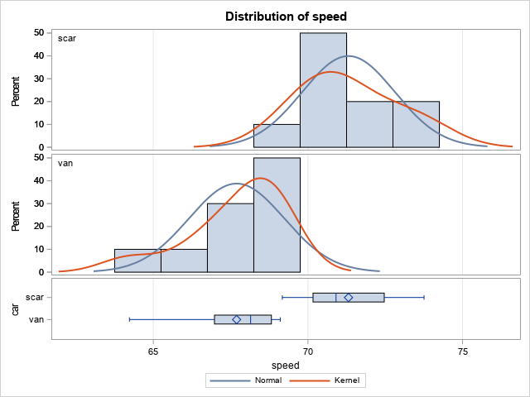
We can look at our assumptions:

Slide 8
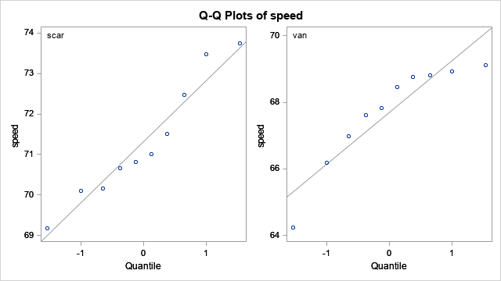
Normality Assumptions:

Slide 9
After this observational analysis, we can conclude at the 95% level that when driving mini-vans people drive slower than when driving sports cars.
And, for this dataset, we could be dead wrong
WRONG!
This is an observational study, and I have no control over who is driving each car.
2. If it was a probability based method WE CAN’T conclude causality.
3. In this dataset, the car had nothing to do with it; rather, people who like driving fast drive sports cars.
4. What is worse we have no real way to tell we are wrong, all of our basic assumptions are reasonably met.
5. The problem is that I need to assign a driver to a car at random.
6. Random assignment of the “driver” in experimental design terminology “experimental unit” is done to minimize the effect of variables we do not know about.

Slide 10
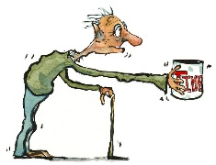
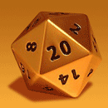

From this perspective, each driver has a response to the treatment “the car” and we want to see if there is a difference between cars. Randomization is our attempt to account for uncontrolled variables that we do not know about.
Idea: I randomly assign the guy to
the car.

Slide 11
Design of Experiments Basic Idea
Determine the main objectives:
What is of interest to be studied? (e.g., differences car type in the example above)
What is the measurement outcome. (e.g., speed in the example above.)
Define the main comparisons. (e.g., Mini-van speed vs. Sports Car speed.)
Define the main experimental unit. (e.g., driver )
Define the study plan.
What is an important difference (e.g., is 0.1 mph important to detect or 10 mph).
Determine study design
Defines how variables that are to be controlled by the experimenter.
Figure out how big of a sample size you need to reasonably detect a difference. – Power.
Optimality criterion. (discussed later)
Randomization – assign experimental units to “treatments.”

Slide 12
Design of Experiments Basic Idea
4. Analyze the data based upon the experimental design.
Attempt to account for variables that were not controlled for.
Check model assumptions.
Only look at effects that were defined in the first step.

Slide 13
Nomenclature
Most of you will do A/B testing, but this is not what everyone will call it.
AB testing is also known as randomized controlled trial or a completely randomized design.
All of these things are the same thing!
The experimenter assigns “experimental units” to one treatment, which comes from two or more treatment conditions. The set of treatment conditions is called a “factor.” We want to see if there are differences between the treatments or groups of treatments, or if the factor in general changes the response.

Slide 14
Definitions:
Factor – Experimental variable of interest that potentially affects the response variable.
Treatment – Changes or levels of the factor. Usually only one treatment in a given factor is assigned to an experimental unit.
Experimental unit – The object to which the treatment is applied.
Blocks – Additional variables that should be accounted for, but can not be ‘controlled for in the experiment.’ These are nuisance variables that are not of interest, but could lead to erroneous results if not accounted for.

Slide 15


Example: Humana looked at changing its web page banner:
Web Visitors were randomly assigned to two different banners on Humana's website
Vs:

Slide 16
In this experiment, there is one factor to consider:
The changing banner on the website:
The factor had two treatments
1) The original banner
2) A newly redesigned banner.
Experimental Units:
Unique people visiting the website.
Randomization:
People are randomly assigned either the original banner or the newly redesigned banner.
Blocks:
None

Slide 17
Analysis Types
T-Test- Basic test when there is only one factor and two treatments.
ANOVA- Versatile method that incorporates all variability from the experiment. Multiple factors can be analyzed simultaneously and multiple treatments within a factor are possible. Additional covariates i.e blocks, can be accounted for.
Fishers Exact Test- Test used when for categorical data that are not normal and normal approximations above are not appropriate (usually small sample sizes).
Likelihood Ratio Tests: Used in situations were data are not normal to create ANOVA analogous tests.

Slide 18
When designing an experiment:
It is essential to first consider the type of data you are collecting.
This will allow you to :
Plan for the type of analysis
Estimate the power based upon the analysis type.
Determine the optimal sample size.

Slide 19
Other things:
Treatment Contrast- Planned tests between treatments in a factor. It can be between two treatments, or it can be between multiple treatments in a given factor. For example, if one is looking at three fertilizers, you can test to see if one fertilizer is better than both of the other fertilizers combined.
Power- Ability of one to detect a difference if it does exist. This is a function of – The sample size N, and the size of the actual difference.
Main effects- The effect directly attributable to the treatment.

Slide 20
Run – A full replicate of a given experimental design.
Estimate – The model based estimate of the treatment you are interested in.
Confounding or Aliased – Experimental design where you can not estimate a specific quantity.
Synergism or Higher order effect – Effect that changes with two factors.
Balanced Design – Special statistical term that implies the same number of observations are in each treatment group.
Factorial Design – Design where there are more than two factors. It usually is designed so that specific higher order effects (usually 2nd order) are not aliased with other estimates. (more on this later).
Orthogonal Design – (more on this later)

Slide 21
Example 1: T-Test
A chair of an English department wanted to know the efficacy of two teachers in his program. Students were randomly assigned to a class and after the course a test was taken to determine their writing ability.
Factor: Teacher’s teaching style
Treatment: Two college professors
Experimental Unit: College Freshman
Planned Comparison: Difference in scores using a paired T-Test

Slide 22
/*English data in class
grp = 1 Teacher 1
grp = 2 Teacher 2
*/
data class;
input class score;
cards;
1 35
2 52
1 51
2 87
1 66
2 76
1 42
2 62
1 37
2 81
1 46
2 71
1 60
2 55
1 55
2 67
1 53
;
/*t-test on the above example*/
proc ttest data = class;
class class; /*class is the group assignment 1 = Class 1*/
/*2 = Class 2*/
var score; /*variable for the t-test*/
run;

Slide 23
Proc T-Test Results
class | Method | Mean | 95% CL Mean |  | Std Dev | 95% CL Std Dev
1 |  | 49.4444 | 41.4644 | 57.4245 | 10.3816 | 7.0123 | 19.8888
2 |  | 68.8750 | 58.5927 | 79.1573 | 12.2991 | 8.1318 | 25.0320
Diff (1-2) | Pooled | -19.4306 | -31.1515 | -7.7096 | 11.3169 | 8.3599 | 17.5151
Diff (1-2) | Satterthwaite | -19.4306 | -31.3642 | -7.4970
Method | Variances | DF | t Value | Pr > |t|
Pooled | Equal | 15 | -3.53 | 0.0030
Satterthwaite | Unequal | 13.823 | -3.50 | 0.0036

Slide 24
Hypothesis H₀: Teachers are the same.
Hypothesis H_{a}: Teachers are different.
Conclude: At the α=0.05, we conclude that the teachers have different effectiveness as evaluated by student’s end of course writing proficiency.

Slide 25
More on Hypothesis testing:
For us: The key on hypothesis testing is to note we are trying to falsify the null hypothesis. That is we never accept the null as true we are just saying the null isn’t true and there is more evidence for the alternative hypothesis.
Experimental design is thus: More about saying things are not true than saying something is true.
We want to control the probability that we decide the null isn’t true, when it is true.

Slide 26
Decision Tree
State of Nature | Choose H_{a} | Choose H_{o}
H₀ True | Error – Type I α | 1-α
H_{a} True | β | Error– Type II 1-β

Slide 27
On Power:
Power is the probably we reject the null when it is not true.
For normal models this value depends upon:
The size of the effect (usually mean difference in our case).
The variability of the population.
The type of test used and number of tests (multiplicity testing).
The sample size.

Slide 28
On Power:
For simple problems, including normal models SAS can calculate the power we reject the null for a series of situations.
This can help us in two ways:
Design a study with a high probability of success. (save money)
Find out the probability (after the fact) that our result is true. That is if we are not getting any differences, what is the probability given our sample size that we actually observed something.

Slide 29
proc power in SAS
proc power;
twosamplemeans
test=diff
meandiff = 5 to 25 by 5 /* vary the mean difference*/
stddev = 5 to 15 by 5 /* vary the standard deviation of the groups*/
ntotal = . /*find the n */
power = 0.9; /*we want a 90% probability to find a differences
if the above is true*/
run;

Slide 30
Computed N Total
Index | Mean Diff | Std Dev | Actual Power | N Total
1 | 5 | 5 | 0.912 | 46
2 | 5 | 10 | 0.903 | 172
3 | 5 | 15 | 0.901 | 382
4 | 10 | 5 | 0.929 | 14
5 | 10 | 10 | 0.912 | 46
6 | 10 | 15 | 0.904 | 98
7 | 15 | 5 | 0.939 | 8
8 | 15 | 10 | 0.917 | 22
9 | 15 | 15 | 0.912 | 46
10 | 20 | 5 | 0.948 | 6
11 | 20 | 10 | 0.929 | 14
12 | 20 | 15 | 0.903 | 26
13 | 25 | 5 | 0.993 | 6
14 | 25 | 10 | 0.932 | 10
15 | 25 | 15 | 0.913 | 18
Our power was about 93%

Slide 31
Power Curve
proc power;
twosamplemeans
test=diff
meandiff = 5
stddev = 5 /* vary the standard deviation of the groups*/
NTOTAL = 1 to 300 by 5
POWER = .;
/*now look at the graph*/
/* 90% is my cutoff ref=0.9)*/
PLOT X=N MIN=1 MAX=300 STEP=1 MARKERS=none YOPTS= (REF=0.9 CROSSREF=yes);
run;

Slide 32
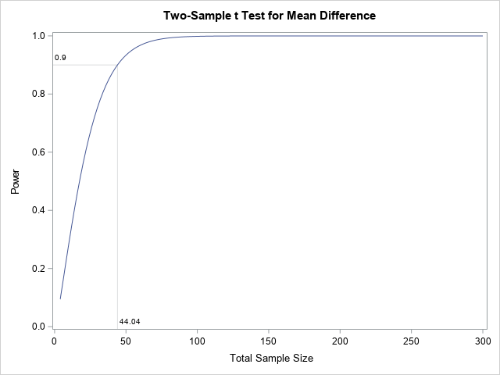

Slide 33
Different SD
proc power;
twosamplemeans
test=diff
meandiff = 5
stddev = 15
NTOTAL = 1 to 400 by 5
POWER = .;
/*now look at the graph*/
/* 90% is my cutoff ref=0.9)*/
PLOT X=N MIN=1 MAX=400 STEP=1 MARKERS=none YOPTS= (REF=0.9 CROSSREF=yes);
run;

Slide 34
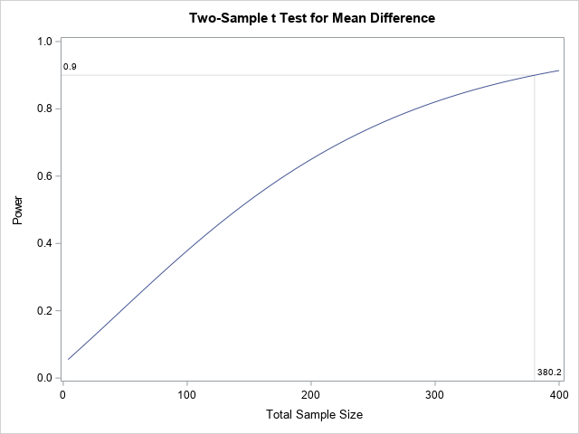

Slide 35
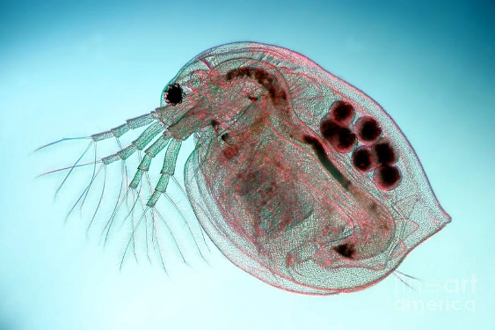
Example 2:
A study was designed to determine the effect of copper concentrations in water on the lifetime of the Daphinia Magna. Fifteen Daphinia were randomized to three treatments: 0 µg/L , 20 µg/L, and 40 µg/L.
Factor: Copper Exposure
Treatments: 0 µg/L , 20 µg/L, and 40 µg/L.
Randomization: Fifteen Daphinia assigned to the treatments random assignment.

Slide 36
Example: Data
0 μg/L | 20 μg/L | 40 μg/L
60 | 58 | 40
90 | 74 | 58
74 | 50 | 25
82 | 65 | 30
 | 68 | 42

Slide 37
Example (Cont):
Contrasts:
Difference between 0 µg/L and 20 µg/L
Overall Test Level:
α = 0.05

Slide 38
/* data for example 2
in Lecture 1*/
data dubia_exp;
input dose age;
cards;
0 60
0 90
0 74
0 82
20 58
20 74
20 50
20 65
20 68
;
proc ttest data = dubia_exp;
class dose;
run;
quit;

Slide 39
proc ttest results
Our test was not significant at the
α = 0.05 level
Method | Variances | DF | t Value | Pr > |t|
Pooled | Equal | 7 | 1.84 | 0.1079
Satterthwaite | Unequal | 5.3441 | 1.77 | 0.1330
dose | Method | Mean | 95% CL Mean |  | Std Dev | 95% CL Std Dev
0 |  | 76.5000 | 56.1431 | 96.8569 | 12.7932 | 7.2472 | 47.7002
20 |  | 63.0000 | 51.4853 | 74.5147 | 9.2736 | 5.5561 | 26.6483
Diff (1-2) | Pooled | 13.5000 | -3.8246 | 30.8246 | 10.9218 | 7.2212 | 22.2288
Diff (1-2) | Satterthwaite | 13.5000 | -5.7232 | 32.7232

Slide 40
There is not enough evidence to conclude a difference between between the 0 μg and the 20 μg doses? Did we have enough power?
Let’s see using proc power:
Assume:
The difference we saw was real.
The observed variance is real.
We are using a t-test for the difference

Slide 41
/*what was the (approximate) power to detect a difference between
the two groups. Note: our sample size per group is not even*/
proc power;
twosamplemeans
test=diff
meandiff = 13.5
stddev = 10.9
ntotal = 9
power = .;
run;

Slide 42
Fixed Scenario Elements
Distribution | Normal
Method | Exact
Mean Difference | 13.5
Standard Deviation | 10.9
Nominal Total Sample Size | 9
Actual Total Sample Size | 8
Number of Sides | 2
Null Difference | 0
Alpha | 0.05
Group 1 Weight | 1
Group 2 Weight | 1
We only had a 31.5% chance to detect a difference.
Computed Power
Power
0.315

Slide 43
What is the sample size we need for a 90% probability to detect the difference?
/* Again assuming the mean is true, look at this over a range
of values. */
proc power;
twosamplemeans
test=diff
meandiff = 13.5
stddev = 10.9
ntotal = 5 to 50 by 2
power = .;
PLOT X=N MIN=1 MAX=50 STEP=1 MARKERS=none YOPTS= (REF=0.9 CROSSREF=yes);
run;

Slide 44
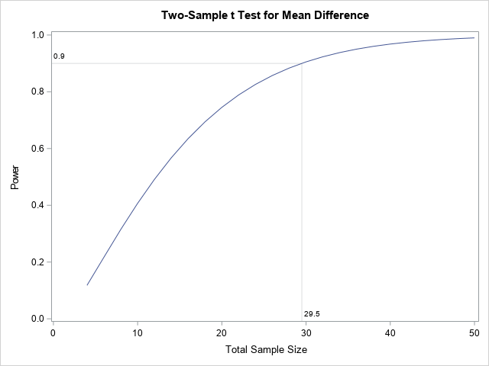

Slide 45
If this difference is true, our study was too small!
We really needed about 30 observations (15 per group) to detect this difference at a high probability.
If this is an important difference: We wasted money!

